Slide 1
Progressing Child and Adolescent Training
Paul Bailey

Slide 2
Long Term Athlete Development & Periodisation of Training
Learning to Train (8-12 yrs)
/
General Physical Preparation Phase
Training to Train (11-16 yrs)
/
Specific Preparation Phase
Training to Compete (15-23 yrs)
/
Pre-competitive Phase
Training to Win (18+ yrs)
/
Competitive Phase
Competition
/
Peak Phase
LTAD
Periodisation
The above boxes represent different phases of training. Depending on age, each phase could vary in duration from 5 weeks for an adult, to 2-3 years for a child. Each phases of training will be governed by 4 variables:
Frequency of training, Intensity of training, Time spent training and Type of training. These are called the FITT principles.
The following will also be important influencers of what goes into each training phase:
Training should be Specific and Progressive, should Overload the body, should allow Recovery, and should avoid Tedium. These are known as the SPORT principles

Slide 3
Learning to Train/General Physical Preparation Phase
If your child/athlete has lived a sedentary life, or perhaps has just never trained a particular component of fitness, then time should be taken to ‘ease’ your athlete in. Training should be:
Progressive – start easy and don’t ask too much of your client too soon!
Include technical sessions so that clients understand movement patterns/biomechanics and become competent at them
Educate in order that your clients understand thoroughly why you are asking them to complete this form of training, allowing for greater athlete ‘buy in’
Include enough volume of training at a low enough intensity in order that clients become accustomed to the rigours (physical and psychological) of training and that their body adapts to the stimulus before progression occurs
F – Frequent training
I – Low
T – As high as fitness allows
T – Foundation movements and techniques

Slide 4
Training to Train/Specific Preparation Phase
Once a child/athlete has an understanding and physical capacity to increase their training load, then ‘Training to Train’ can take place. During this phase of training, training load is increased to optimal levels in order that best progression can be made towards goals.
F – Frequent
I – Medium to high (likely following an inverse relationship with frequency of training)
T – Medium to high
T – Progressive movements and technical elements from foundation

Slide 5
Training to Compete/or for optimal performance
Competition does not have to mean participating in a race or other competitive sporting event – it could just mean competing against oneself! Having a specific goal can focus thoughts and training and help clients to strive for more.
F – Frequent
I – Medium to high (likely following an inverse relationship with frequency of training)
T – Medium to high
T – Progressive movements and technical elements from foundation

Slide 6
Training to Win/Pre competitive Phase
There is no training like competition. When a child or athlete is fully prepared, then using races or other sporting events to motivate can often take training loads to new levels!
F – Less frequent
I – High (with low intensity active recovery sessions)
T – Medium
T – All energy systems used

Slide 7
Competition/Peak Phase
The result of all the hard work!
F – Less frequent
I – High (with low intensity active recovery sessions)
T – Medium
T – All energy systems used

Slide 8
LTAD
LTAD and or periodisation is never a steady ‘linear’ progression. Growth spurts, regressions in ability etc will all happen along the way. It is therefore important to keep in mind the long-term objectives of training, and see youth competition as just part of the learning journey.

Slide 9
Can you only weight train when you get to a certain age?
Resistance training for children and adolescents has for a long time been frowned upon. However, research is showing that it can play a hugely important role in both the health and sporting potential of our young people. Strength & Conditioning training is an integral part of most sports these days – so practicing it from a younger age prepares the athlete for later in their LTAD journey.
Research indicates that appropriately designed, and well supervised resistance training programmes can benefit youth of all ages, with children as young as 5 years of age making noticeable improvements in muscular fitness.
However, most gyms for insurance purposes (and staff expertise) will not allow under 16’s in unless in a specialist session.

Slide 10
‘Weight training’ or ‘Strength & Conditioning’
Typically we think that you must lift weights in order to be stronger, faster or better at sport. In fact, much more emphasis is now spent on ‘Conditioning’ the whole body – not just the muscles. Flexibility, mobility, and neurological adaptation play a huge part in injury prevention and power development.
Conditioning training could include: Pilates, Yoga, stability and stretching and Plyometric training such as; jumps, hops, skips, bounds and throws
In terms of what to do and when – then before an athlete can do anything they should have flexibility. Once that is acquired then they should learn movement patterns linked to training and their sport. Balance and stability come next. Once an athlete has mastered all of those things, they can do loaded ‘weight training’ exercises

Slide 11
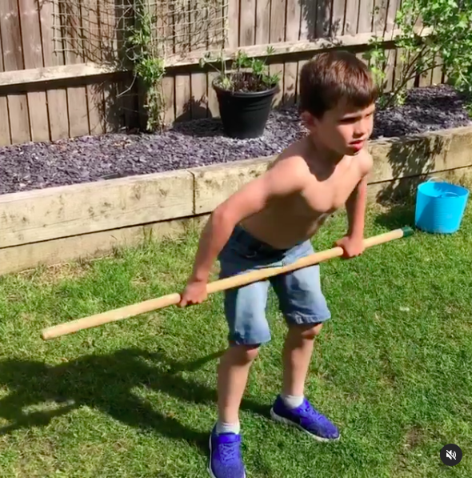
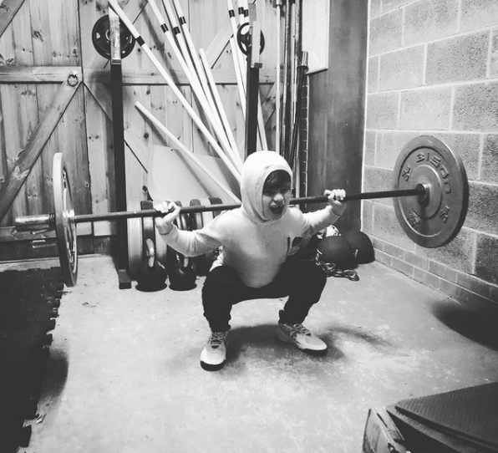
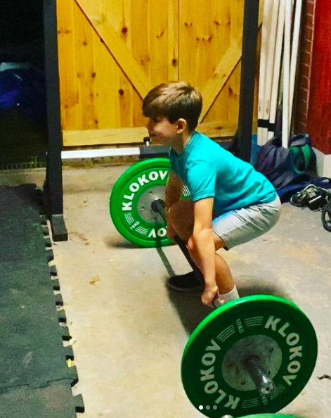
Flexibility - Movement pattern - Balance and stability - loaded exercise
Aged 7
Aged 8
Aged 6

Slide 12
Childhood strength
Throughout childhood strength increases in a linear fashion
Strength increases in childhood appear to be related to development of the central nervous system:
Motor unit recruitment
Firing frequency
Synchronisation
Neuro myelination (myelin sheath increasing conductivity of nerves)

Slide 13
Adolescent strength
Strength increases at onset of puberty
Boys strength increases are significantly greater from this point
Girls strength increases are still relatively linear from this point
Strength increases result due to presence of androgens including:
Testosterone
Human Growth Hormone
Insulin-like growth factor
Increases in strength are the result of:
Increase in cross-sectional area
Muscle pennation angle (direction of muscle fibre within the muscle)
Muscle fibre differentiation (fast/slow)

Slide 14
Biological v chronological age
Growth due to the onset of puberty occurs at different times and at different rates for children. Therefore, children of the same chronological age may be disadvantaged against children of a higher biological age. Differentiation must occur in order to provide child-specific programmes from a safety and a developmental point of view
Additionally, training age must be taken into account. A child with a higher training age, but lower biological or chronological age of a peer may be capable of more from a strength or motor skill perspective

Slide 15
Health benefits
The health benefits of resistance training for children and adolescents include:
Musculoskeletal health
Body composition
Cardiovascular health
Injury prevention
Additionally, due to it’s nature, resistance training holds less impact and motor control related issues for sedentary children who may be overweight or obese, than more traditional sports or activities. In fact, resistance training could play an important role in preparing these young sedentary people for further activity or sport

Slide 16
Health risks
There has been a widely held belief that resistance training from a young age can adversely affect a child’s growth and also be a potential injury risk. Growth plate fractures have often been cited as being of particular risk. In fact, there is no scientific evidence to suggest that this is true. Conversely, resistance training and other high stress inducing sports have been shown to be beneficial for bone formation and growth.

Slide 17
Expectations
Strength gains of 30-40% for untrained children
With 4-5 years of training, relative strength levels (1RM kg/kg body mass) in the back squat should be a minimum of 2.0 for late adolescents (16-19 yrs); 1.5 for adolescents (13-15 yrs); and 0.7 for children (11-12 yrs). (Keiner et al, 2012)

Slide 18
Resistance training recommendations for children
Programmes should be:
Aimed at developing movement pattern
Aimed at developing strength
Aimed at instilling confidence
Programmes should not be:
Aimed at increasing muscle mass
A Long term approach to athlete development should be implemented:
Programmes should last longer than 8 weeks
Programmes should be appropriately periodised
Reducing training frequency with increased training intensity best

Slide 19
Training guidelines
Training experience | Beginner | Intermediate | Experienced | Advanced
Volume (sets x reps) | 1-2 x 8-12 | 2-4 x 6-10 | 2-4 x 5-8 | 2-5 x 2-5
Total number of exercises per session | 6-10 | 3-6 | 3-6 | 2-5
Intensity (% 1RM) | BW or up to 50-70% | 60-80% | 70-85% | 85-100%
Repetition velocity | Moderate-fast | Moderate-fast | Fast-maximal | Maximal
Rest intervals | 1 | 1-2 | 2-3 | 2-5
Frequency (sessions per week) | 2-3 | 2-3 | 2-4 | 2-5
Recovery (hours between sessions) | 72-48 | 72-48 | 48 | 48-24

Slide 20
Coaching of children and adolescents
Feedback is an integral part of a coach’s role. A coach should provide regular feedback based on their situational ability. Feedback may be rep by rep, or may be set by set according to the child’s ability and awareness.
When coaching larger groups, less frequent feedback is accepted, though efforts should be made to limit the number of participants a coach is dealing with – especially when the group has members of a low training age or ability

